Slide 1
The Scientific Publication Process
Taylor Hughes
Vidya Madhavan
Nadya Mason
Lance Cooper

Slide 2

You’ve discovered a supermassive black hole at the center of the universe!
Now what ???
Write the paper.

Slide 3

Who, me?
Who decides when a paper should be written?
Usually, the research advisor (but can be influenced by justification from students)
Who writes the paper? Usually …
The student or postdoc who led the project the most (intellectual contribution, time spent working) writes the draft.
All major contributors agree on outline, figures, main ideas.
There’s lots of input from the research advisor.
Secondary contributors (just providing materials or making characterization measurement) may be less involved, but have to agree with final draft.
Who gets to be an author?
Anyone who has made a significant contribution (i.e., could the paper, including figures, have been written without this contribution?). Helping a friend for a day usually doesn’t count.
The contribution could be intellectual (ideas, data analysis) or practical (managing equipment, taking data).
It’s good to discuss authorship while working on a project (“if I make these measurements would I be on a manuscript that results from them?”). Aim for generosity but not misrepresentation.

Slide 4

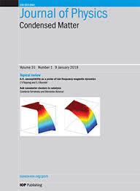
How long should the paper be? In what style? For what audience?
This all depends on the what your findings are…
Based on your findings you choose a journal…
Visit journal websites, read description:
“Science is a weekly, peer-reviewed journal that publishes significant original scientific research, plus reviews and analyses of current research and science policy. We seek to publish papers that are influential in their fields or across fields and that will substantially advance scientific understanding. Selected papers should present novel and broadly important data, syntheses, or concepts. We welcome submissions from all fields of science and from any source.”
“Journal of Physics: Condensed Matter covers the whole of condensed matter physics including soft matter, biophysics and the physics of chemical processes. Papers may report experimental, theoretical and simulation studies. We will also consider papers that cover the fundamental physics of applications and devices….To be publishable in Journal of Physics: Condensed Matter papers must fit the scope of the journal and meet the highest scientific quality standards. In addition, they should contain significant and original new science and make a substantial advance within a particular area of condensed matter physics.”

Slide 5
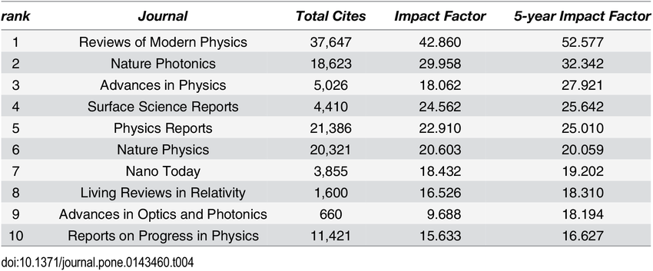
It’s useful to look at journal impact factors
But impact factor is just one element. Also consider:
Reputation in field (PRB, PRA are highly reputable but may have smaller impact factors)
How broad or specific to field your results are
How many pages you need to fully describe results

Slide 6

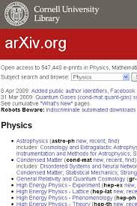
Time passes … You write a beautiful paper. You want to submit to Physical Review Letters.
But PRL has a long review process … and you want people to know about your results NOW.
- you want the broader community to vet the results before publication
- PRL subscription is expensive and not everyone has access to it
- you want to claim priority
Solution: submit to the Physics arXiv, https://arxiv.org/ …
The Physics arXiv is “an open access repository of electronic preprints”
“The physics archive was started in August 1991 and includes astro-ph, cond-mat, gr-qc, hep-ex, hep-lat, hep-ph, hep-th, math-ph, nucl-ex,nucl-th, physics and quant-ph.”

Slide 7
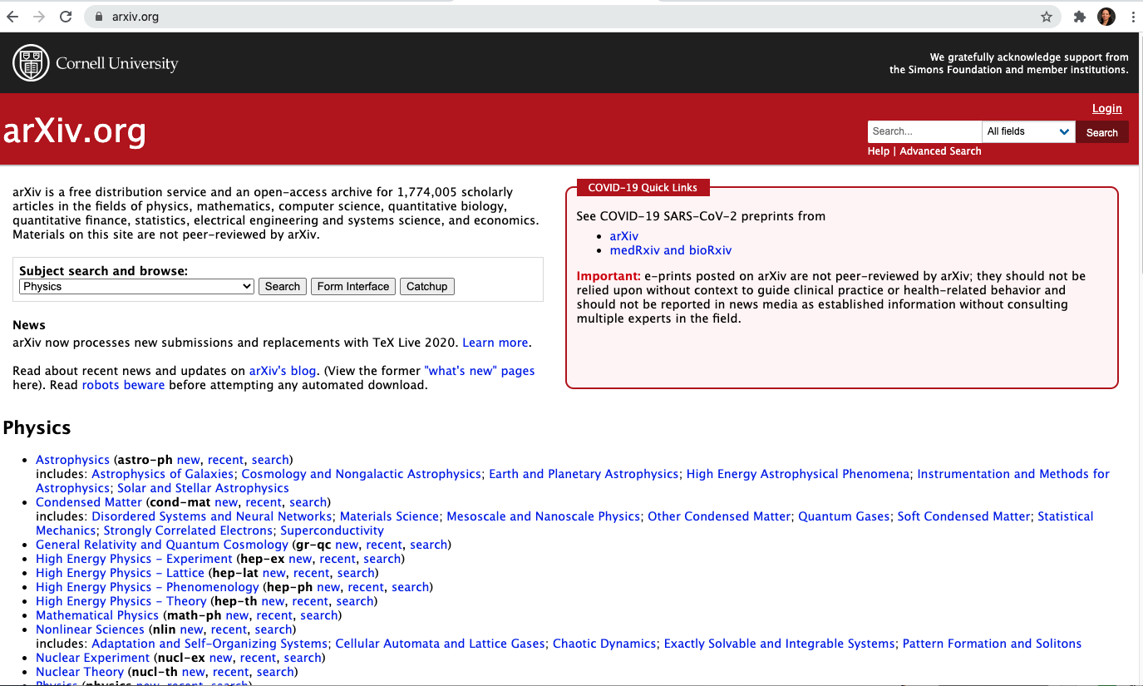

Slide 8
In some fields, researchers submit to only arXiv, and not to traditional peer-reviewed journals (this is more common for large collaborations).
You generally cannot submit a version to arXiv that has already gone through an editorial process at a journal.
Many scientists scan through arXiv every day for the latest and greatest in the field.
In the meantime, you’ve submitted your paper to PRL. What now?

Slide 9
(Note: all slides that follow are shamelessly pasted from a presentation by S. Lance Cooper, Prof. of Physics, Director of Graduate Studies, and former Divisional Editor for Physical Review)
(Also, the following is for a Physical Review submission, but a very similar process is followed at all peer-reviewed journals)

Slide 24
If at first you don’t succeed…
Even if a paper is rejected from one journal, it may be suitable for a different journal.
Sometimes the “rejecting” journal recommends another more specialized journal.
At this point, the paper can be modified or re-written to address referee reports and/or to make it more suitable for a different journal – or it can be re-submitted as is.

